Slide 1

TEAM 07
STOCK MARKET ANALYSIS USING AWS

Slide 2



TEAM MEMBERS
DEVIKINANDAN
PRAVALIKA
VARUN

Slide 3

INTRODUCTION
The stock market is highly volatile and requires robust data processing for accurate insights.
Cloud computing enables scalable and efficient analysis of large financial datasets.
AWS (Amazon Web Services) provides powerful tools for real-time data streaming, storage, and machine learning.
This project leverages AWS services to analyze stock market trends, predict price movements, and visualize key insights.

Slide 4



PROBLEM
STATEMENT
REAL-TIME STOCK DATA IS HARD TO PROCESS WITH TRADITIONAL METHODS.
KAFKA ON EC2 STREAMS DATA; SAGEMAKER PROCESSES IT; S3 STORES IT.
GLUE & ATHENA ENABLE FAST QUERYING FOR INSIGHTS.

Slide 5

PROPOSED
SOLUTION
THIS PROJECT BUILDS A SCALABLE STOCK MARKET ANALYSIS PIPELINE USING AWS SERVICES. KAFKA ON EC2 STREAMS REAL-TIME DATA, WHICH IS PROCESSED IN SAGEMAKER AND STORED IN AMAZON S3. AWS GLUE ORGANIZES THE DATA INTO STRUCTURED TABLES, WHILE ATHENA ENABLES FAST QUERYING FOR INSIGHTS. THIS SOLUTION ENSURES EFFICIENT STOCK DATA PROCESSING AND ANALYSIS IN A CLOUD-BASED ENVIRONMENT.

Slide 6
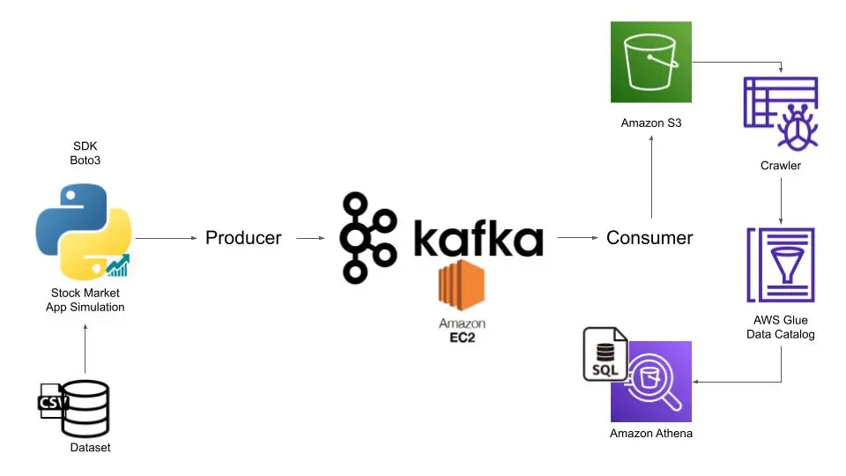
ARCHITECTURE

Slide 7
PROJECT TIMELINE
02/15/2025
02/22/2025
02/28/2025
03/12/2025
Data Extraction
Data Transformation
Data Loading
Secure Storage
03/19/2025
04/02/2025
04/23/2025
Monitoring
Data Visualization
Data Analysis

Slide 8
GITHUB LINK
HTTPS://GITHUB.COM/VARUNGAZALA16/DSCI-6007-03-AWS-PROJECT

Slide 9


